Slide 1
Recursive Latent Alignment Multi-scale Precipitation Downscaling via Foundation Model Embeddings
Rishab Sakalkale, Kassidy He, Yunxi Zeng

Slide 2
Table of Contents
01
02
03
04
Introduction
Data and Models
Problem statement, motivation, and related works
Data description and baseline + CFM model design
Results
Concluding Remarks
Experimental results and challenges faced
Limitations and future direction of the project

Slide 3
01
Introduction

Slide 4
Research Problem
This project investigates the potential benefits of AlphaEarth (AEF) embeddings in the probabilistic downscaling of low-resolution ERA5 precipitation data.

Slide 5

Background
High-resolution precipitation fields are critical for hydrological modeling, agricultural planning, and infrastructure risk assessment. Global reanalysis products such as ERA5 provide physically consistent atmospheric states at 25 km resolution, but are far too coarse for applications that require sub-kilometer detail.
Notes:
Earth observation data such as ERA5 is critical for climate related tasks. This is accessed at the 25 km resolution, but is often too coarse to be applied for tasks at the sub km level

Slide 6
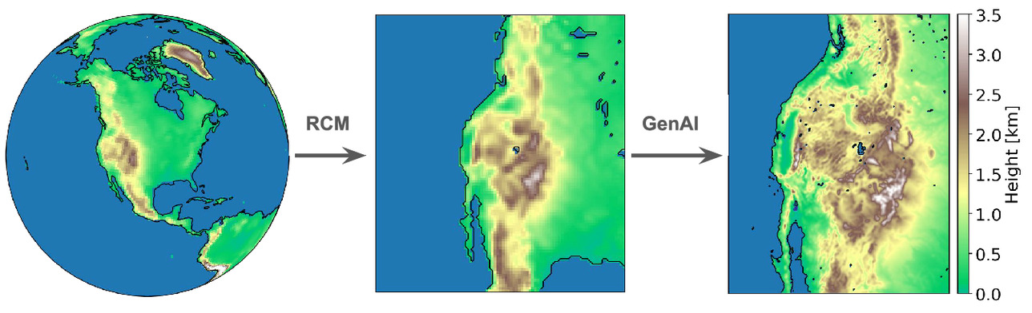
Related Works
Traditional dynamical downscaling use computationally intensive (and deterministic) regional climate models to produce high-resolution data. Most ML approaches are deterministic and cannot provide uncertainty quantification.
Recent probabilistic approaches use diffusion models (see R2-D2¹, CorrDiff²) and flow matching to generate ensembles of downscaled data, but are often trained on climate model-generated data and without terrain conditioning, providing output at multi-kilometer scales.
To our knowledge, no prior work has used GeoFM embeddings as conditioning for climate downscaling.
1. Ignacio Lopez-Gomez, Zhong Yi Wan, Leonardo Zepeda-Núñez, Tapio Schneider, John Anderson, and Fei Sha. Dynamical-generative downscaling of climate model ensembles. Proceedings of the National Academy of Sciences, 122(17):e2420288122, 2025.
2. Morteza Mardani, Noah Brenowitz, Yair Cohen, Jaideep Pathak, Chieh-Yu Chen, Cheng-Chin Liu, Arash Vahdat, Mohammad Amin Nabian, Tao Ge, Akshay Subramaniam, Karthik Kashinath, Jan Kautz, and Mike Pritchard. Residual corrective diffusion modeling for km-scale atmospheric downscaling, 2024.
Notes:
Deterministic, often use RCMs during the intermediate scaling steps.

Slide 7
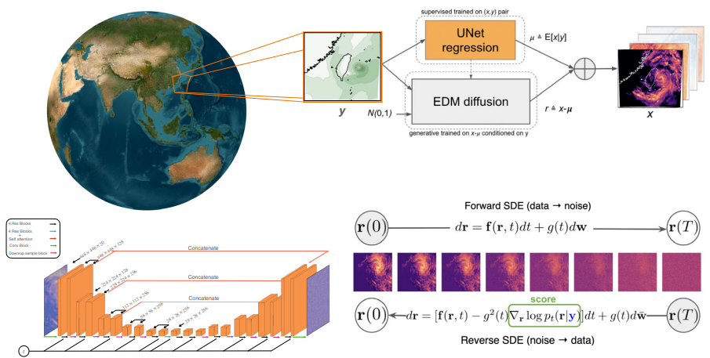
Related Works
R2-D2¹: Uses RCM as intermediate generation step and conditions on terrain height and sub-grid orographic variance - our approach generalizes this by using the AEF embedding as terrain conditioning.
CorrDiff²: Trains diffusion model (probabilistic) but uses no terrain conditioning. Both dataset and model are much larger and achieve good results, but can AEF embeddings provide rich-enough information to reduce the needed training environment?
1. Ignacio Lopez-Gomez, Zhong Yi Wan, Leonardo Zepeda-Núñez, Tapio Schneider, John Anderson, and Fei Sha. Dynamical-generative downscaling of climate model ensembles. Proceedings of the National Academy of Sciences, 122(17):e2420288122, 2025.
2. Morteza Mardani, Noah Brenowitz, Yair Cohen, Jaideep Pathak, Chieh-Yu Chen, Cheng-Chin Liu, Arash Vahdat, Mohammad Amin Nabian, Tao Ge, Akshay Subramaniam, Karthik Kashinath, Jan Kautz, and Mike Pritchard. Residual corrective diffusion modeling for km-scale atmospheric downscaling, 2024.

Slide 8
Project Abstract
We propose a framework for probabilistic precipitation downscaling from 25 km ERA5 data to 1.5 km resolution over Illinois, conditioned on AEF embeddings as terrain-aware covariates. Our approach recursively applies a learned 2x super-resolution operator, generating 100-member ensembles via noise injection. We establish baselines using bicubic interpolation and XGBoost (with and without AEF conditioning), validate against 800 m PRISM observations.

Slide 9
02
Data and
Models

Slide 10
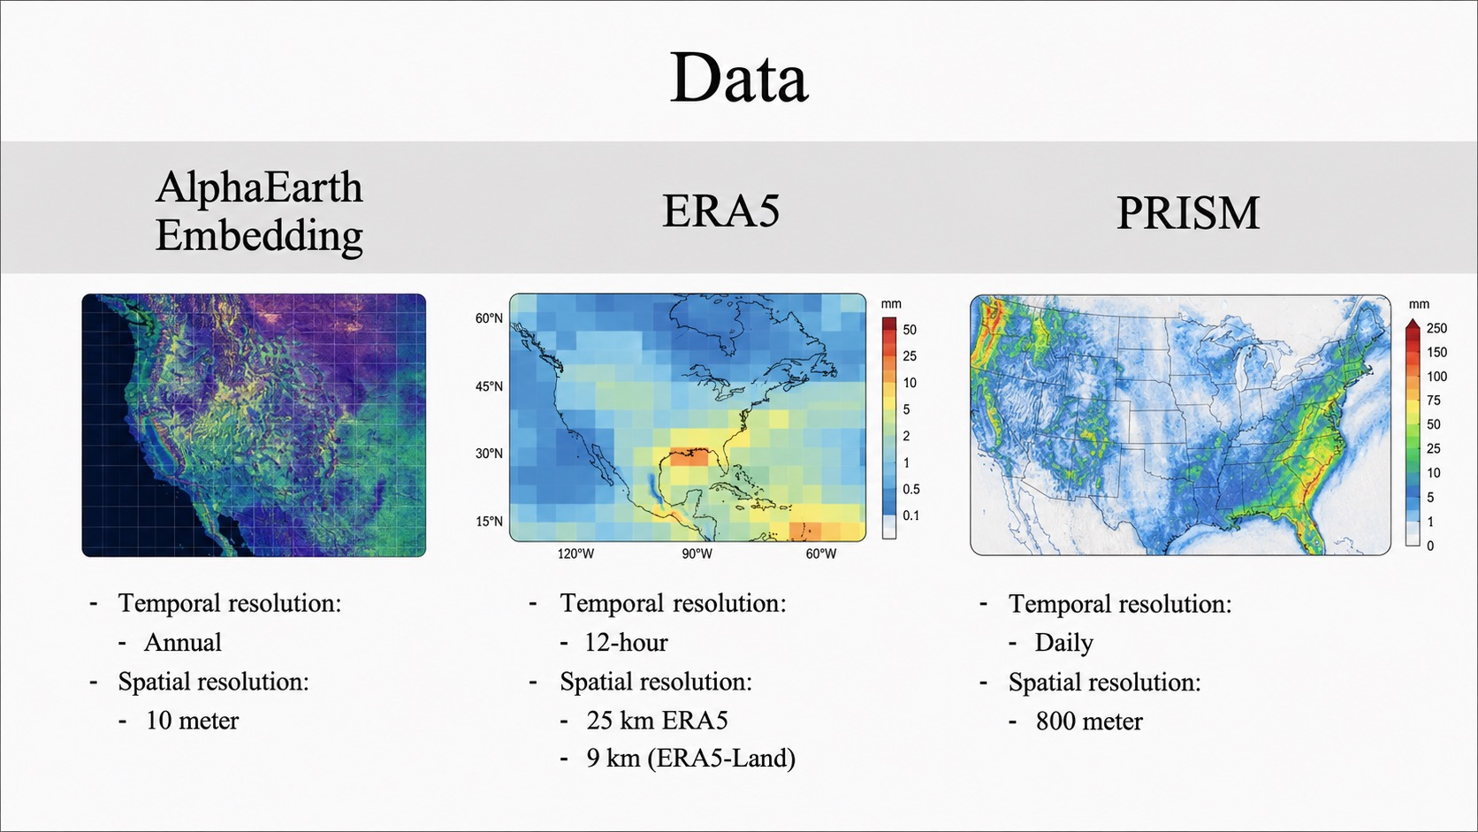
Data
ERA5
PRISM
AlphaEarth Embedding (AEF)
Temporal resolution:
  Annual
Spatial resolution:
10 meter
Temporal resolution:
  Hourly
Spatial resolution:
25 km ERA5
9 km (ERA5-Land)
Temporal resolution:
  Daily
Spatial resolution:
800 meter

Slide 11
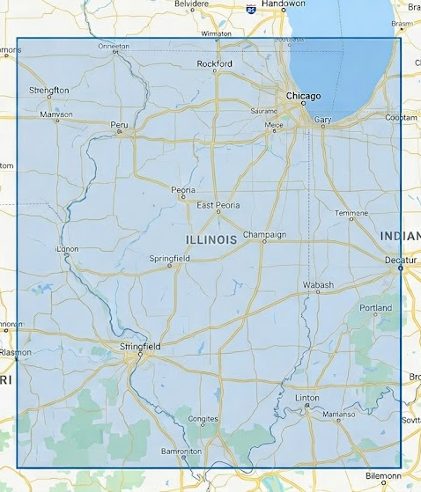
Data (cont.)
Data Scope:
Spatial Range: 36.97-42.51 N, 91.51-87.50 W (Illinois bounding box)
Temporal Range:
  Training data: 2017 - 2024 (2191 days)
  Testing data: 2025 (366 days)
Data Augmentation:
Horizontal Flip, Vertical Flip, Horizontal + Vertical Flip on days with precipitation
1 original data sample → 4 final data samples (1 original, 3 augmented)

Slide 12
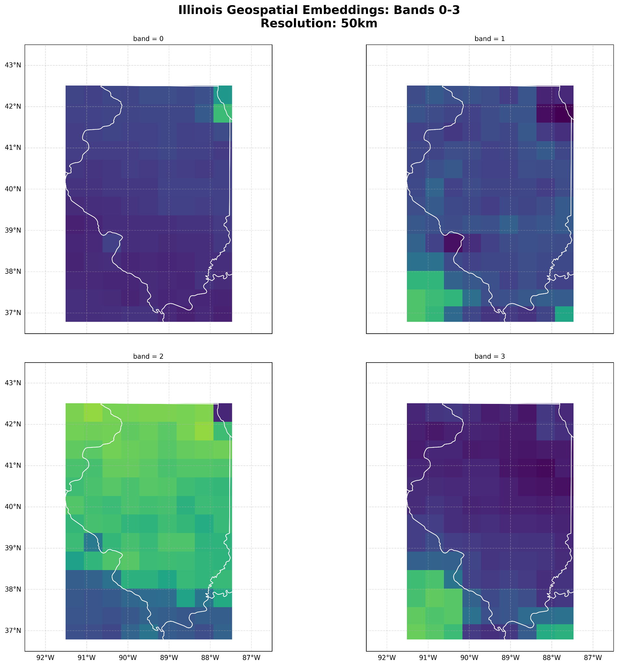
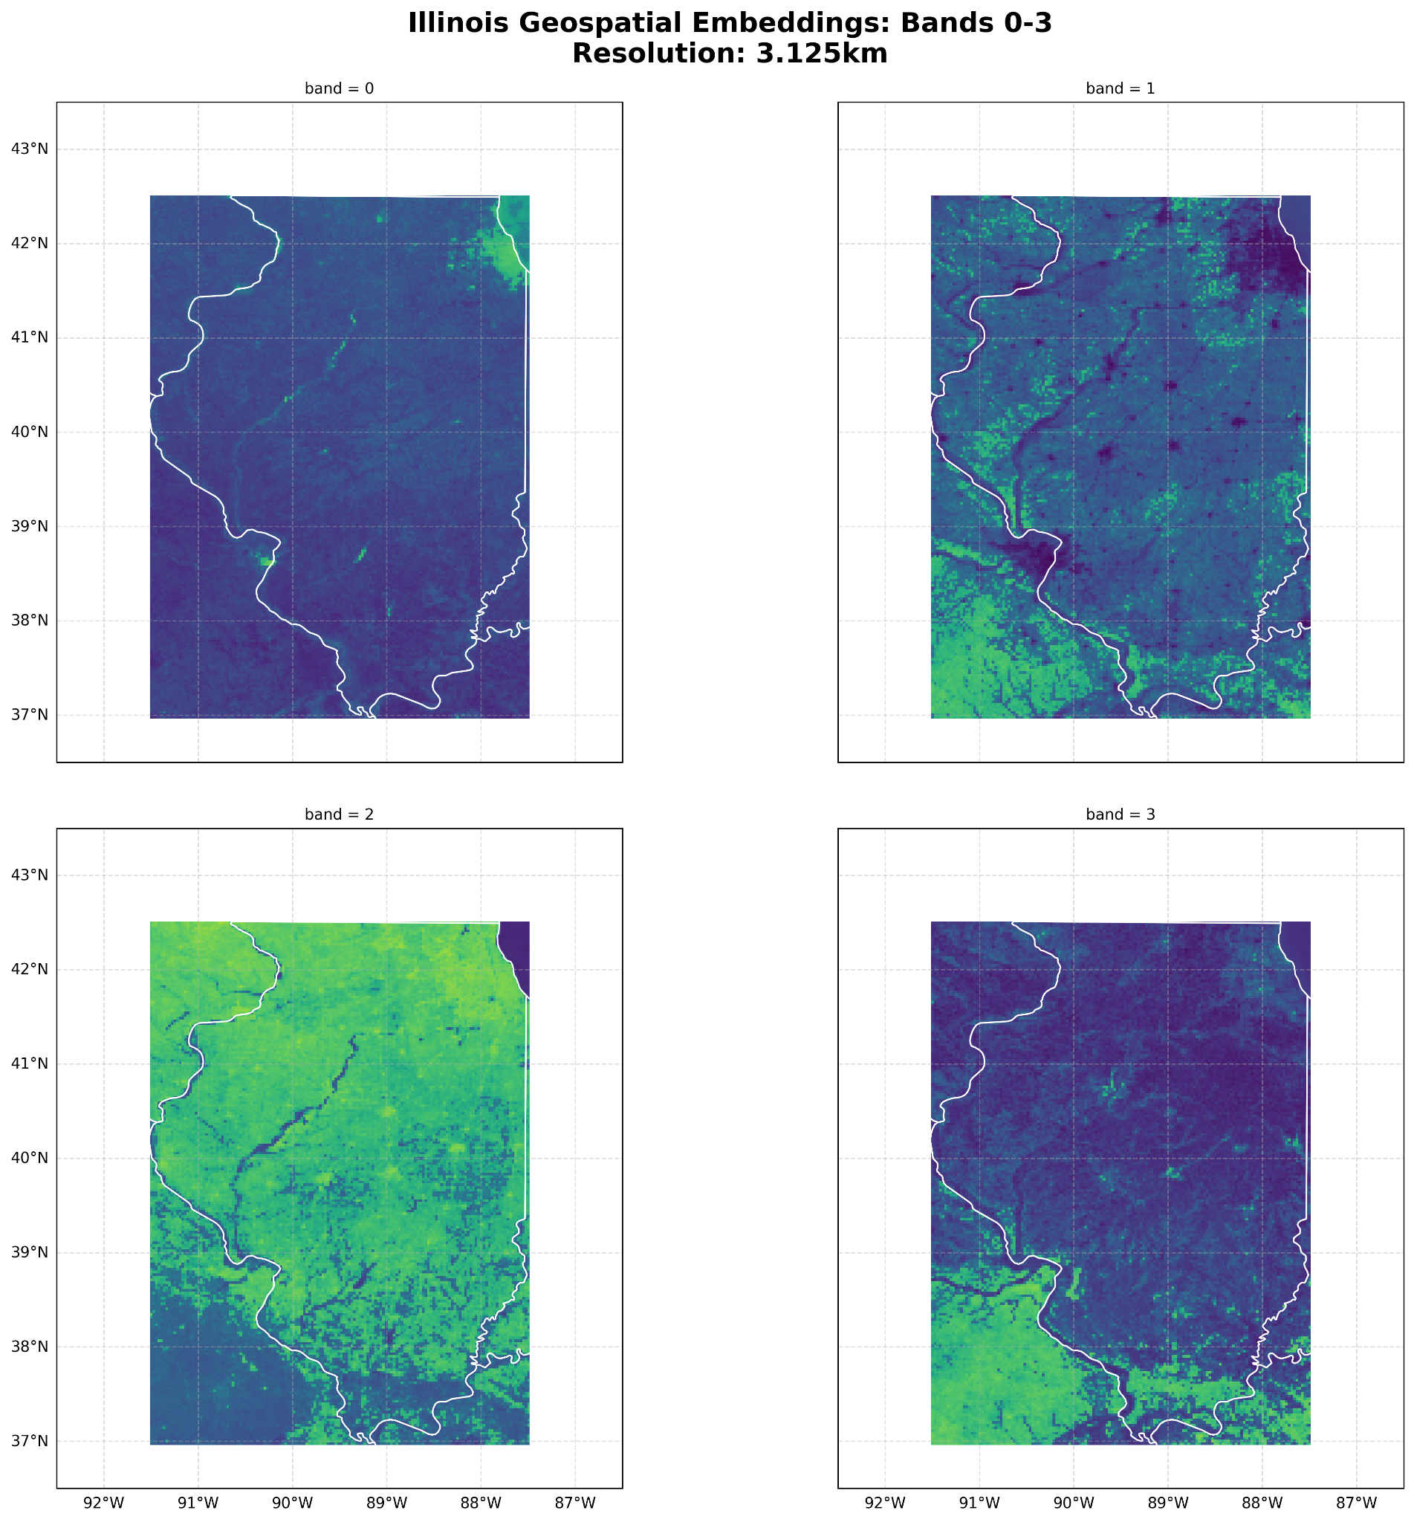


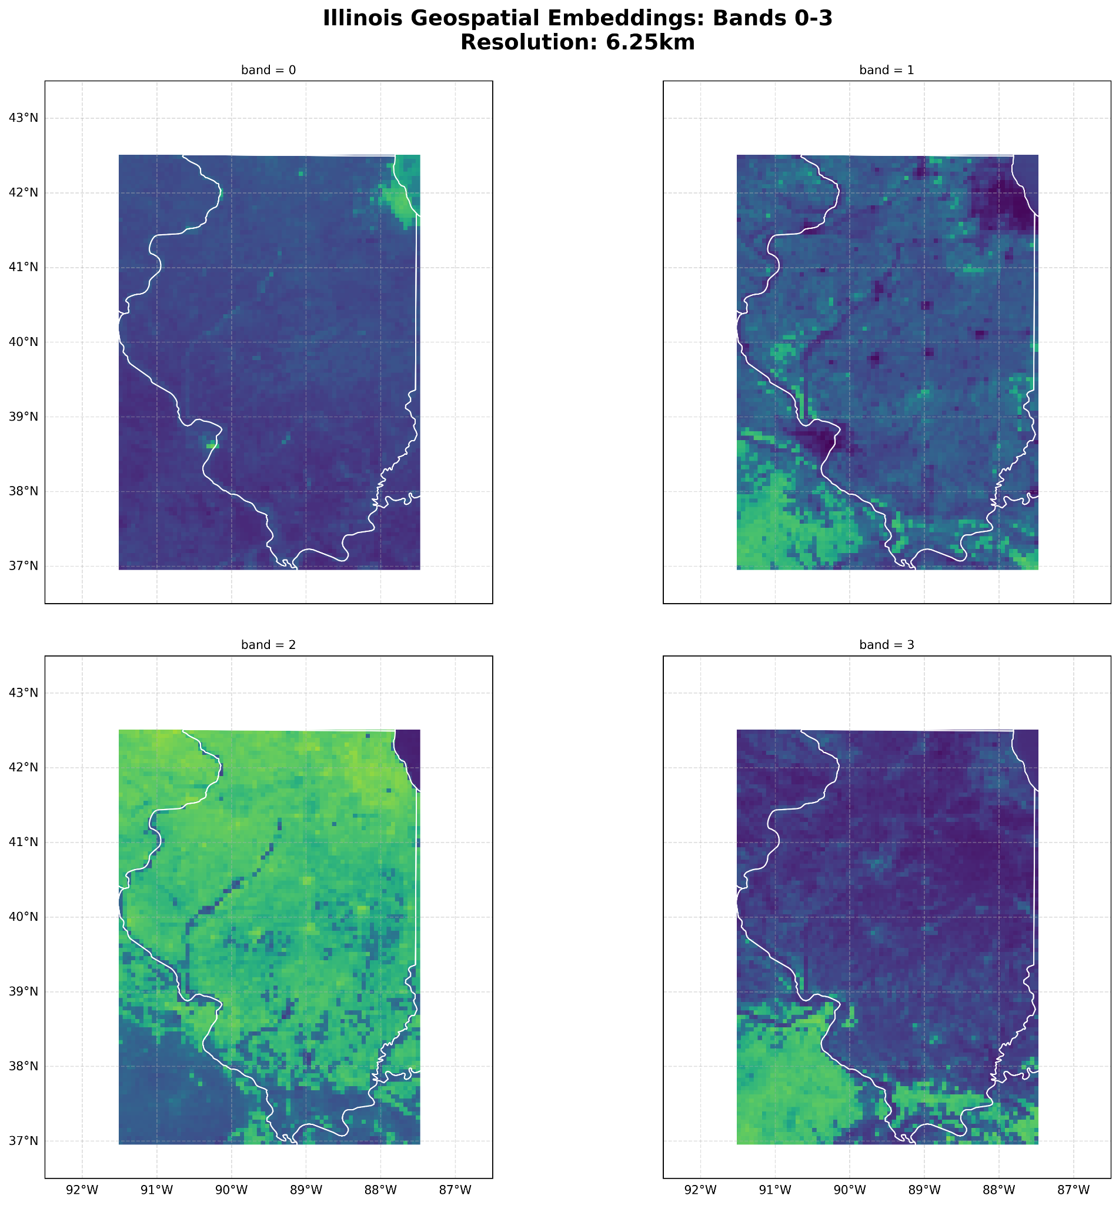

AlphaEarth Embeddings

Slide 13
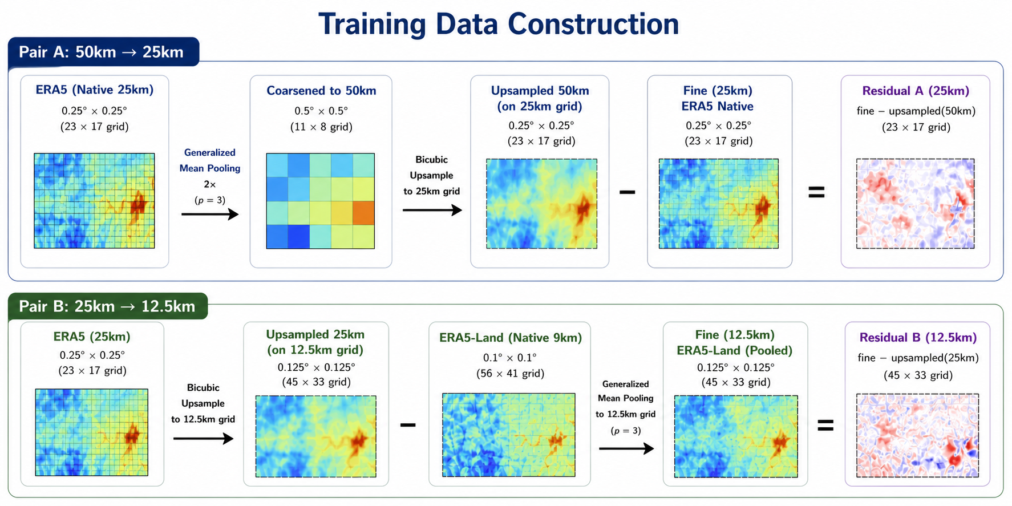
Training Data Construction
Note: Training target is log-space residual

Slide 14
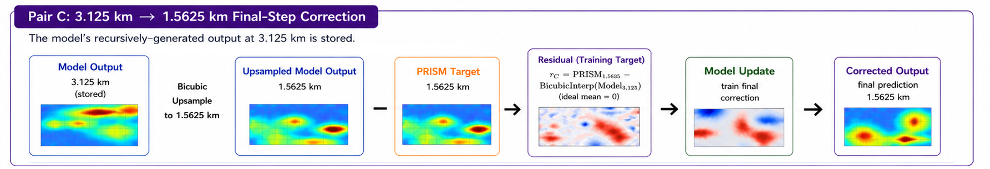
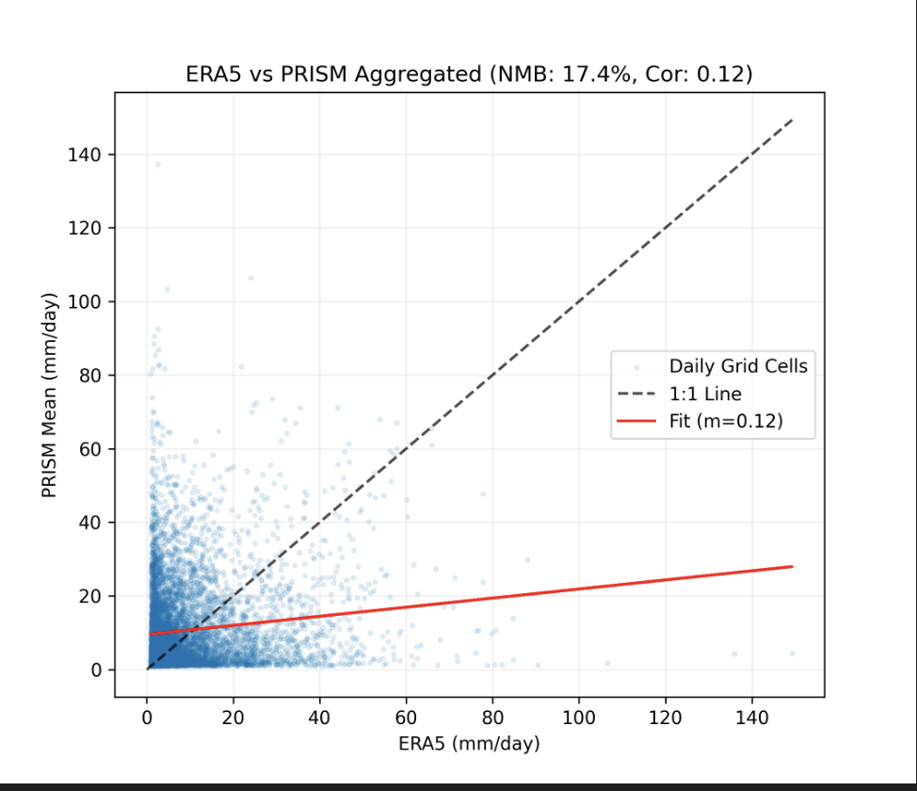
Training Data Construction (cont.)
ERA5 vs. PRISM data as ground truth. Low correlation, and shows the effects of ERA5’s bias and spatial displacement- underpredicting during high precipitation events and over predicting during lower precipitation events.

Slide 15
Baseline Models
Bicubic Interpolation
  Simple lower bound
XGBoost (No AEF)
  Only 1 feature - log(1 + precipitation_{coarse})
  Target: log-space residual b/w fine grid and bicubic-interpolated coarse grid
  Hyper-parameters: max_depth = 3, min_child_weight = 50 (prevents overfitting)
XGBoost + AEF
  129 features - log(1 + precipitation_{coarse}), 64-dim coarse AEF embedding, 64-dim fine AEF embedding
  Target: log-space residual b/w fine grid and bicubic-interpolated coarse grid
  Hyper-parameters: max_depth = 3, min_child_weight = 50 (prevents overfitting)
  Baseline comparison of potential improvement of geospatial context via embedding

Slide 16
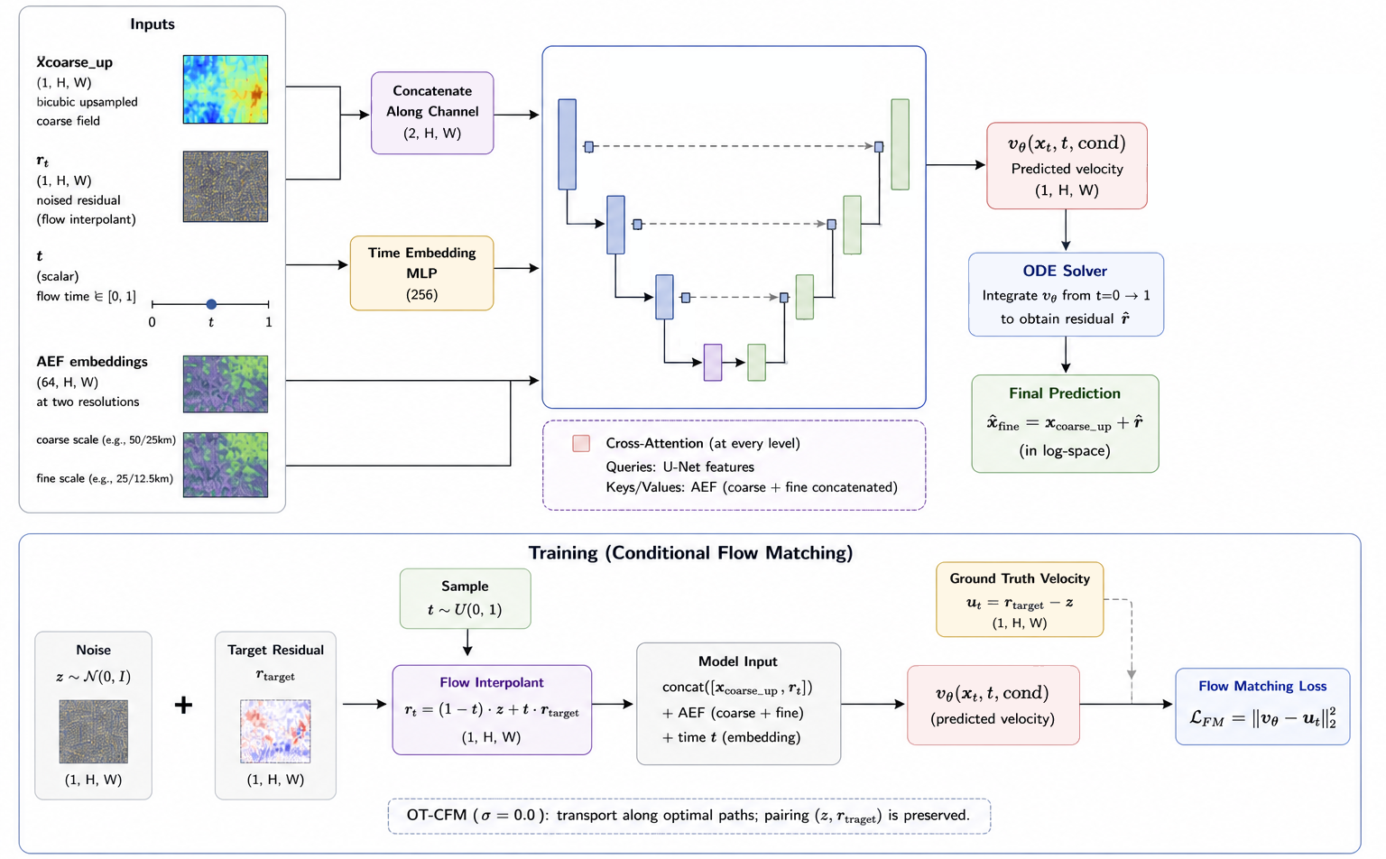
Conditional Flow Matching Model
We use the OT-CFM model from Tong et al. 2023a
Model Details:
- [32, 64, 128] channels per level
- 2 attention heads per level
- SiLU activation
- AdamW Optimizer
- EMA decay = 0.9999

Slide 17
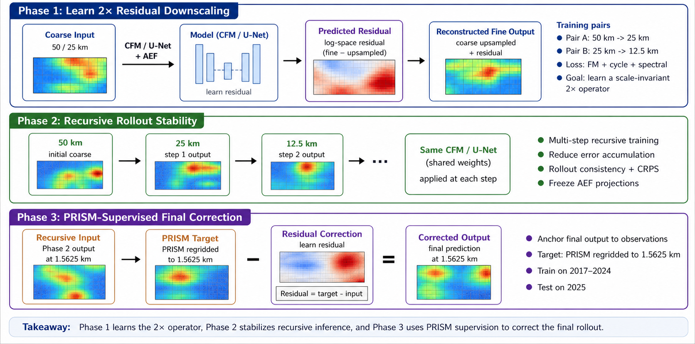
Training Phases

Slide 18
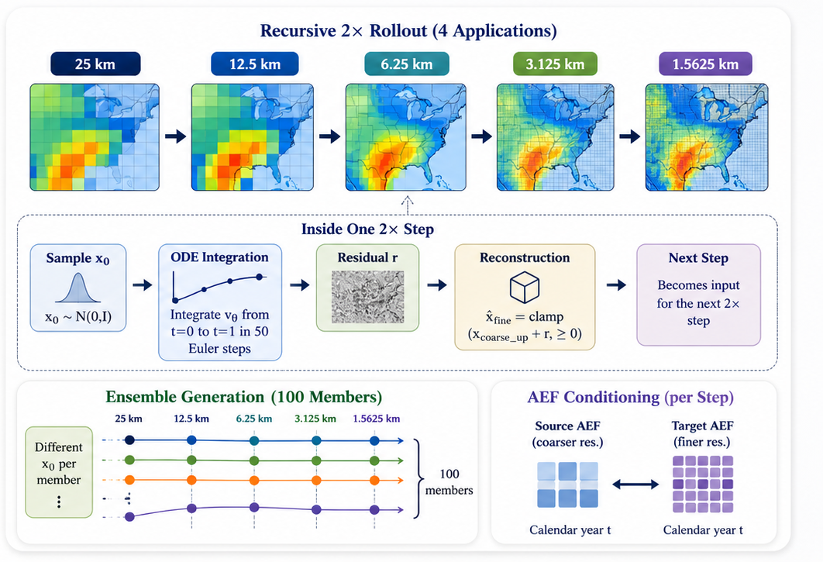
Ensemble Inference

Slide 19
03
Results

Slide 20
Spoiler Alert
The CFM model didn’t work as well as we hoped! :(
Turns out learning a purely data-driven and robust 2x super-resolution operator is kinda difficult!
But it’s okay because we learned a lot and have areas of our project we can iterate and improve on! :)

Slide 21
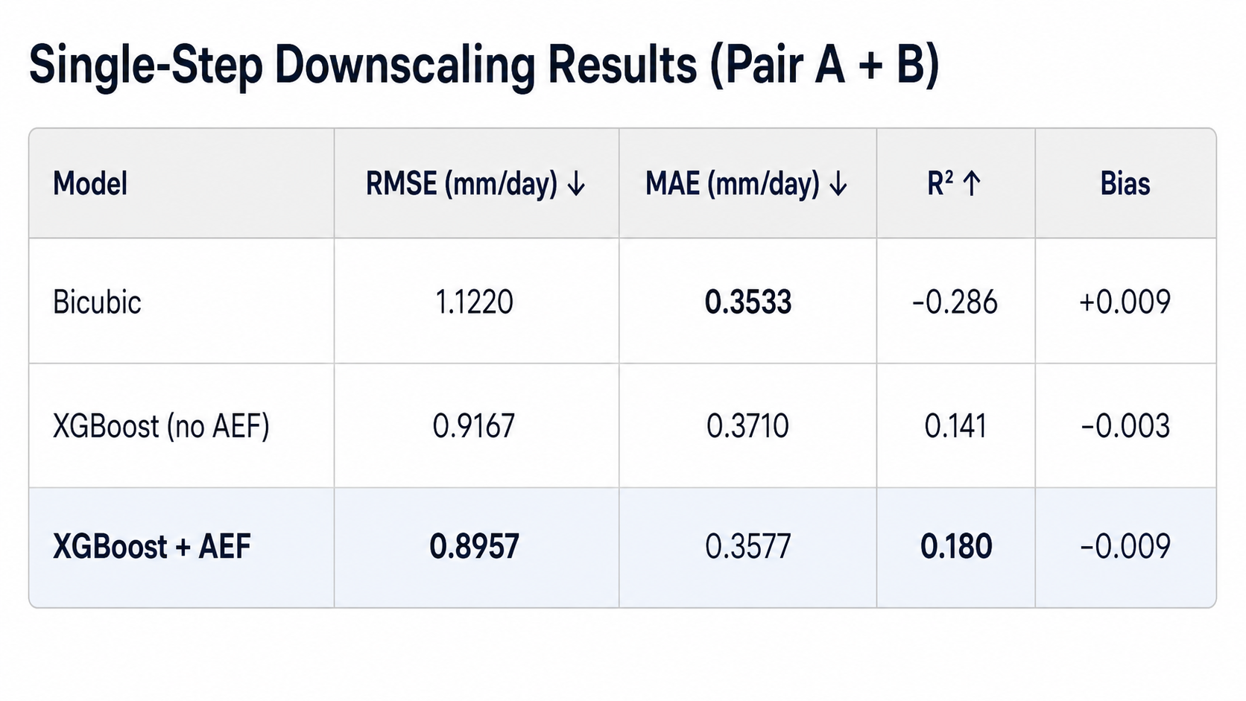
Baseline Model Results
Single-Step Downscaling (Pair A + Pair B)
XGBoost + AEF gives the best overall single-step performance, improving RMSE and R² over both bicubic interpolation and XGBoost without AEF.
Notes:
AEF embeddings improve downscaling skill, XGBoost+AEF reduces RMSE by 20.2% over bicubic (1.12 → 0.90 mm/day) and adds an additional improvement over XGBoost without AEF (0.92 → 0.90). The R² jumps from −0.29 (bicubic, worse than predicting the mean) to +0.18 (XGB+AEF, capturing meaningful variance). Negative R² for bicubic confirms that simply upsampling the coarse field is worse than predicting the spatial mean — bicubic over-amplifies coarse-resolution patterns where they don't belong.

Slide 22
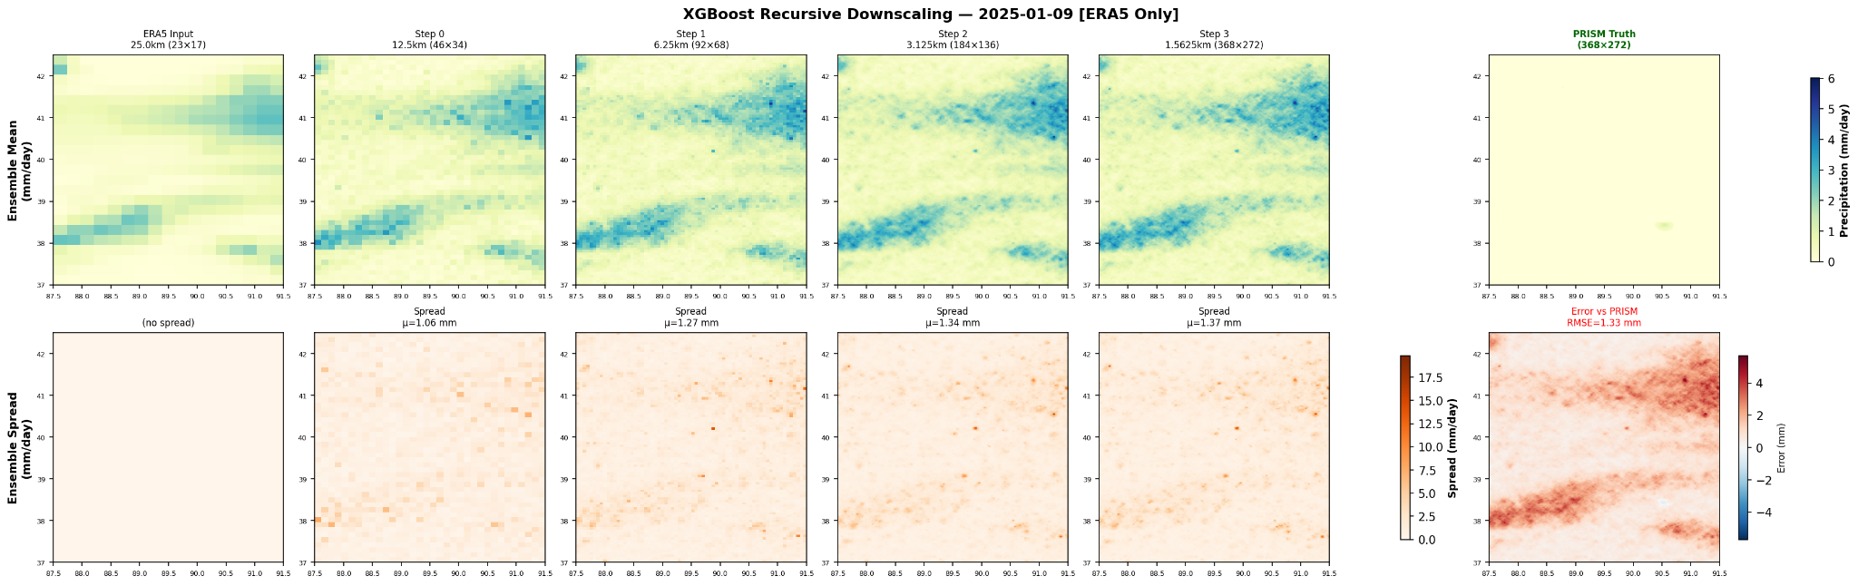
Baseline Model Results
Recursive Ensemble Downscaling vs. PRISM (2025-01-09)
Recursive downscaling increases spatial detail from 25 km to 1.56 km, with uncertainty gradually growing across steps, yet the final downscaled field differs substantially from PRISM truth indicating overprediction and bias between ERA5 and PRISM data
Notes:
The upper plots are the recursive downscaling from ERA5 25 km to 1.5625 km, the right side is the PRISM 800m ground truth, and the down sides are the spread plots for measuring uncertainty, we can see that XGBoost adds more fine-scale texture along the steps, with a gradually growing uncertainty, but it is still very different from the prism ground truth, leading to a larger RMSE, and I think it is because the XGboost overpredicts, and also because of the bias we had between the ERA5 and PRISM data because it is already very different from the start.

Slide 23
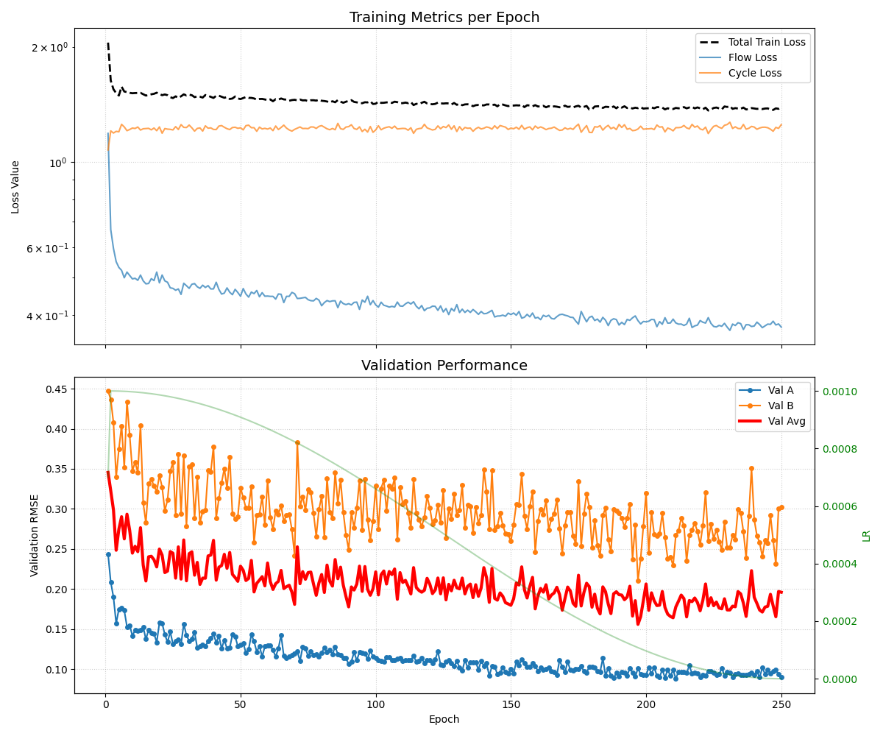
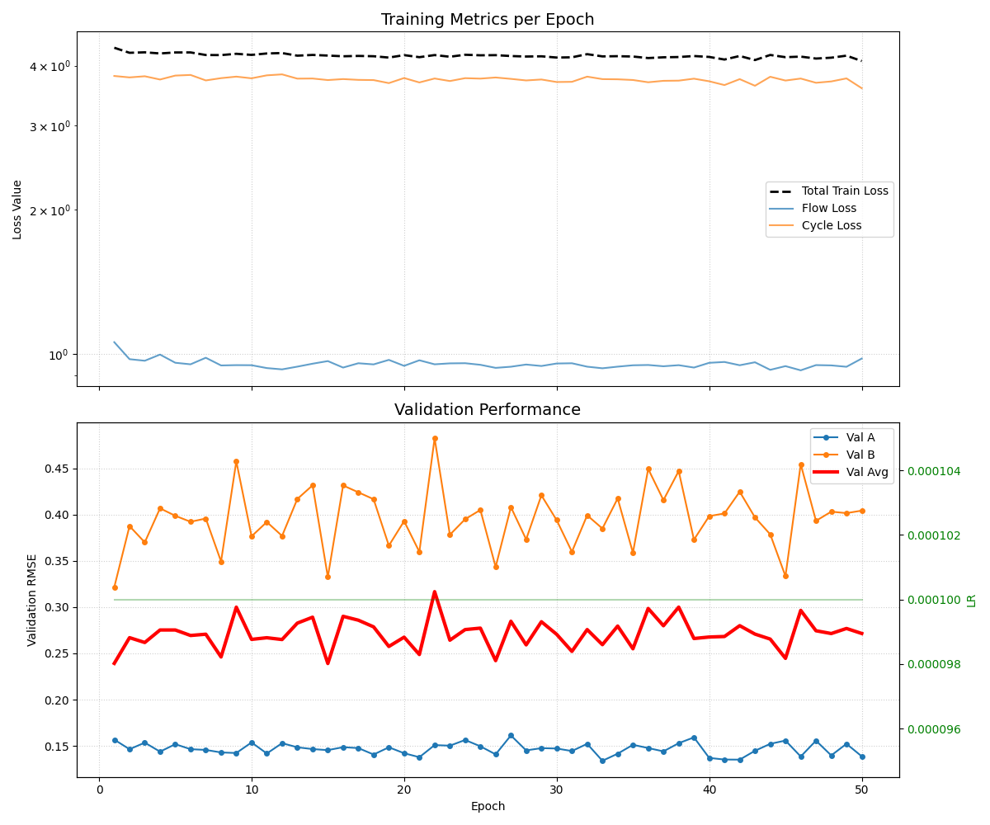
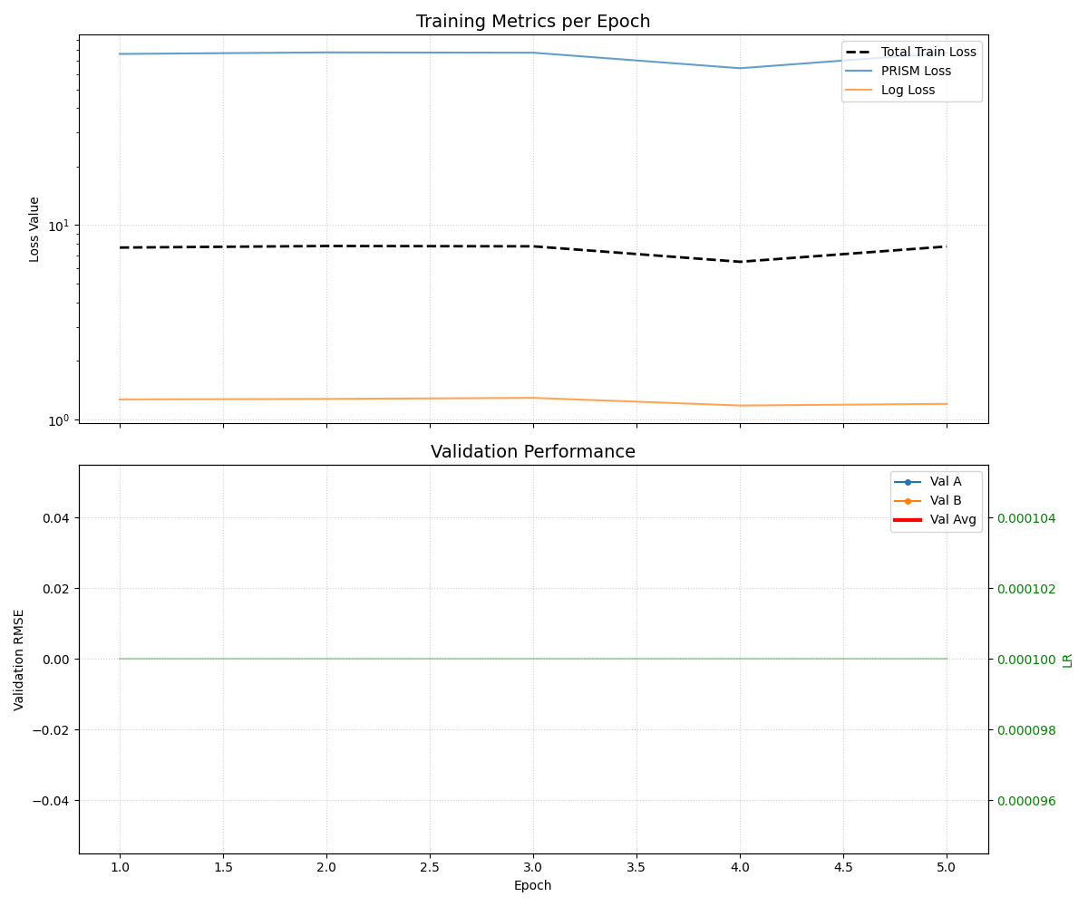
CFM Training Phases
Phase 1 - 250 epochs
Phase 2 - 50 epochs
Phase 3 - 5 epochs
Flow loss converges
Test rmse_mean: 4.3642
No meaningful loss convergence
Test rmse_mean: 4.2741
No meaningful loss convergence
Test rmse_mean: 4.2740

Slide 24
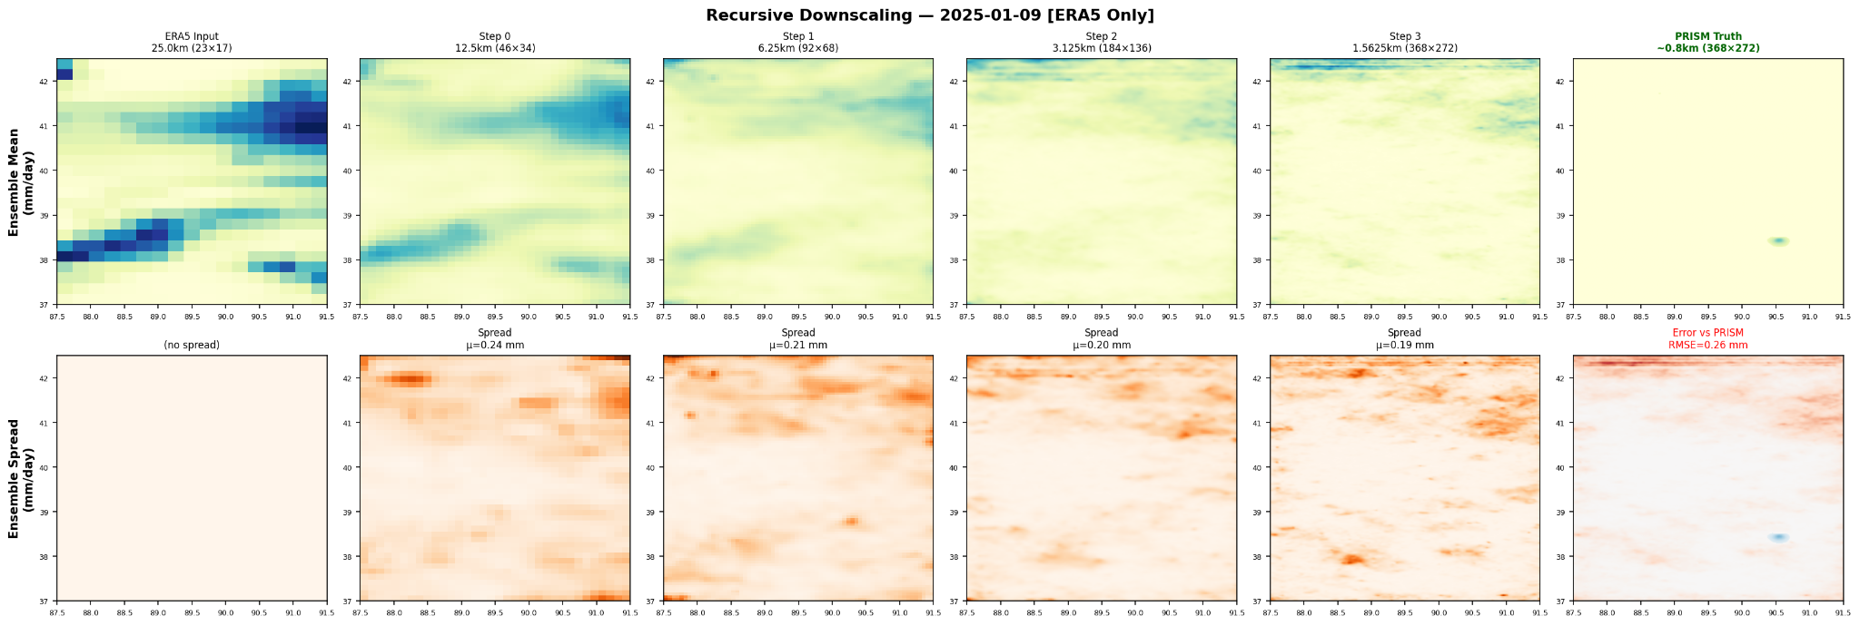
CFM vs. Baselines
CFM Recursive Ensemble Downscaling vs. PRISM (2025-01-09)
CFM produces a smoother and more conservative field that is much closer to PRISM, with a much lower RMSE of 0.26 mm vs. 1.33mm in XGBoost in this example, although its spread decreases rather than grows across steps.
Notes:
CFM produces a smoother and more conservative field that is much closer to PRISM, with a much lower RMSE of 0.26 mm vs. 1.33mm in XGBoost in this example, although its spread decreases rather than grows across steps, meaning the cfm model underestimates,

Slide 25
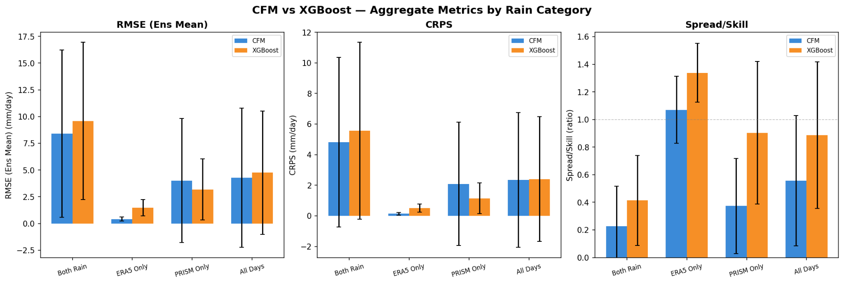
CFM vs. Baselines
CFM is generally more accurate, it tends to produce conservative, uncertain ensembles, while XGBoost tends to overestimate with high certainty inflating its ensemble validation metrics.
Notes:
CFM is generally more accurate than XGBoost in RMSE and CRPS. it tends to produce conservative, uncertain ensembles, XGBoost does has better spread/skill, but as I mentioned, it tends to overestimate with high certainty inflating its ensemble validation metrics. And CFM still needs better uncertainty calibration and we think more data would definitely make it work better

Slide 26
Verification in Data
In 2025 (our test set):
16 days recorded rain in ERA5 and PRISM
7 days recorded in only in ERA5
209 days recorded rain only in PRISM
127 days recorded no rain in ERA5 and PRISM
There is a massive difference in how these two datasets record rain!
Treating PRISM as the ground-truth, ERA5 has a clear dry bias - it only records 7% of rainy days

Slide 27
04
Next Steps

Slide 28
Limitations + Areas to Improve
Our data is severely limited! We have 5600 (augmented ) training samples for a ~3M parameter model.
Downloading/pre-processing AEF embeddings is prohibitively slow, which is why we restricted our spatial region initially
We are only training and testing the Illinois terrain, might be good to extend spatial region to Midwest or CONUS
5600 training data samples are not enough for complex models (AEF is only available from 2017-present)
Extend Training Phase 3 for more epochs to see any improvement in validation against PRISM, though we would need to monitor for catastrophic forgetting.
We need to investigate why the loss never decreased in this phase

Slide 29
Future Work
Try an inherently stochastic model like diffusion to compare its CRPS and other ensemble coverage metrics with the CFM model
Ablation experiments with different foundation model embeddings (Olmo, Prithvi-EO-2.0, Clay, TESSERA, etc.)
This would also allow us to extend the temporal range to pre-2017 (AEF is only available from 2017-present)
Generalized scaling during downscaling steps
Currently trained on 50 km → 25 km → 12.5 km…
Validate intermediate generation steps with other ground-truth datasets (or coarsified PRISM)

Slide 30
Thank You!

